Slide 1


Project 4 Group 3
Alex Stewart
Dawson Marcade
Peter Solis
Courtney Cantwell
Kathy Parrott

Slide 2

Data Selection
We decided to use the UC Irvine Machine Learning Repository as our data source Datasets - UCI Machine Learning Repository
We narrowed our subject to education and Grades
We choose the Higher Education Students Performance Evaluation File donated on 8/14/2023
Yilmaz,Nevriye and Şekeroğlu,Boran. (2023). Higher Education Students Performance Evaluation. UCI Machine Learning Repository. https://doi.org/10.24432/C51G82.

Slide 3
Demystifying Machine Learning by Predicting Grades
Dataset One
“The data was collected from the Faculty of Engineering and Faculty of Educational Sciences students in 2019. The purpose is to predict students' end-of-term performances using ML techniques.”
https://archive.ics.uci.edu/dataset/856/higher+education+students+performance+evaluation YÄ±lmaz N., Sekeroglu B. (2020) Student Performance Classification Using Artificial Intelligence Techniques. In: Aliev R., Kacprzyk J., Pedrycz W., Jamshidi M., Babanli M., Sadikoglu F. (eds) 10th International Conference on Theory and Application of Soft Computing, Computing with Words and Perceptions - ICSCCW-2019. ICSCCW 2019. Advances in Intelligent Systems and Computing, vol 1095. Springer, Cham.

Slide 4
Data Set One:
The purpose of the data was to predict the student’s end-of-term performances
The data was in the form of a .CSV file and contained the answers from 145 students
The students were given 30 questions to answer
With a Student ID, Course ID, and Grade, columns in addition

Slide 5
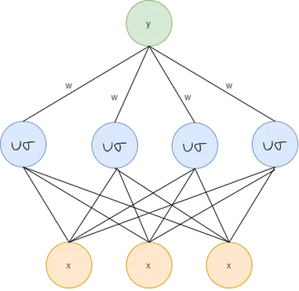
Thought Process
The learning repository recommend using:
Radial-Basis Function Neural Network
This network has a very different architecture than we have been using
The RBF network consist of an input layer, a single hidden layer, and an output layer
So, we decided to process the data using methods we were familiar with
DOI:10.1007/978-3-030-35249-3_76
Corpus ID: 212843193

Slide 6
Data Structuring
We began by structuring the data, so it was easier to analyze.
We started out examining all the 30 parameters with the student grades
The data was in three major categories: personal, family, and educational
The original data was all numerical which was hard to read so, Boolean answers stayed 1/0 but the questions with multiple answers were made more legible by adding the actual answers.
The data was then split up for everyone to work on to try to develop a model that worked.

Slide 7
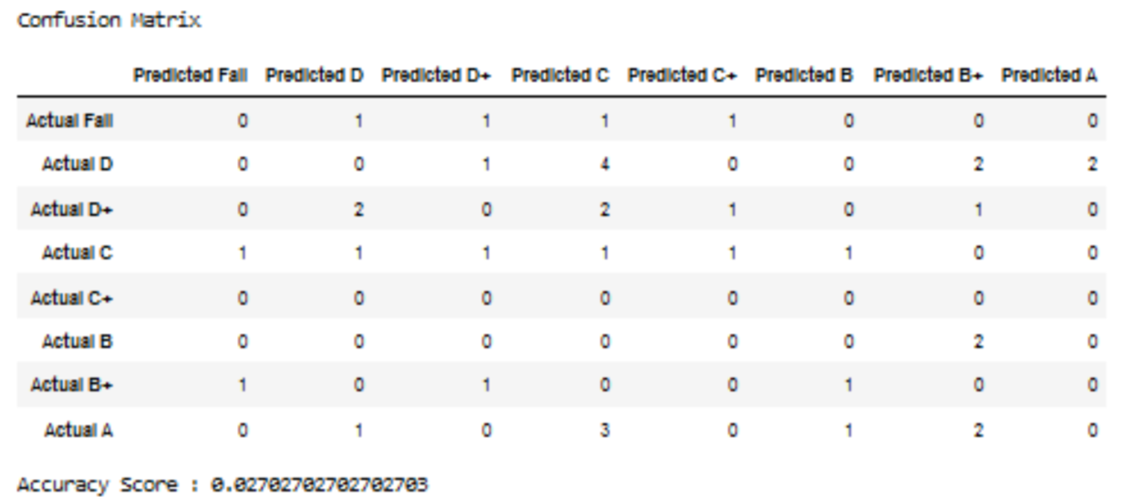
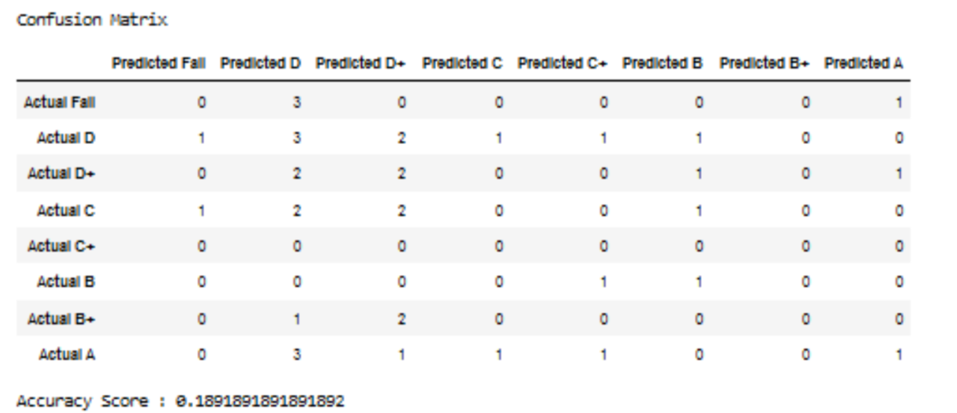
We tried using the Decision Tree Classifier Model for the personal information in the Dataframe but the results did not make any sense, so we abandoned this method. The accuracy was less than 3% on the top matrix and less than 2% on the bottom matrix
Decision Tree Classifier Model

Slide 8
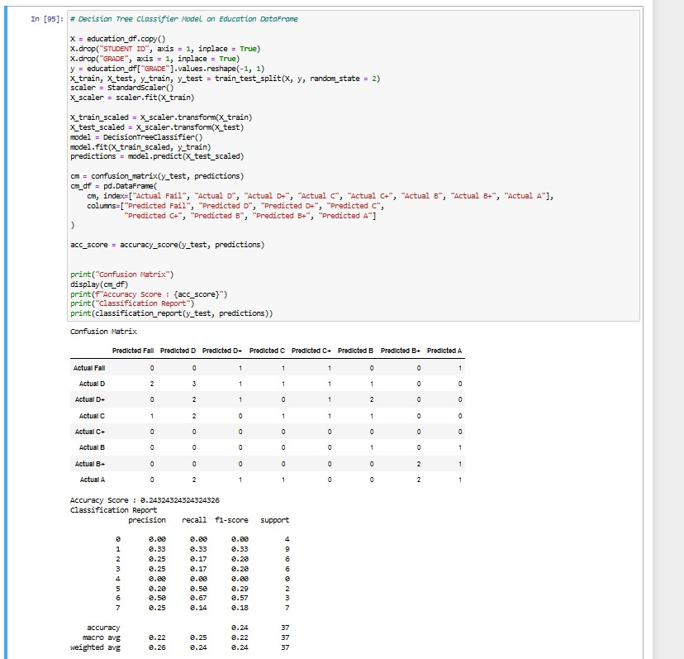
We then tried the Decision Tree Model
The highest accuracy we obtained was only 24%

Slide 9
Moving On…
Data Set Two
The first dataset had very limited success, so we decided to change to a Kaggle dataset
This new dataset has 4,424 student entries
Preliminary data study showed much higher accuracy
In the machine models
This dataset was designed to Investigate the Impact of Social and Economic Factors on education

Slide 10
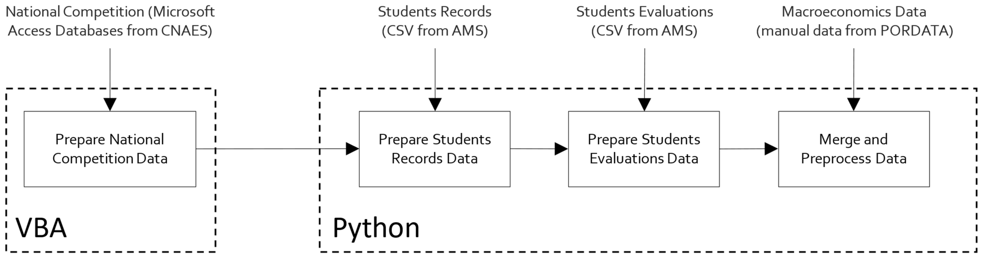
Data File Change
We chose a new data set from Kaggle:
“Predict student’s dropout and academic success”
This dataset contains 30 input variables as well as the student ID and student grade.
The input variables range from Boolean values to multiple key values. The information
was obtained from students enrolled in various undergraduate degrees.
Dataset development workflow design
Realinho, V., Machado, J., Baptista, L., & Martins, M. V. (2022). Predicting Student Dropout and Academic Success. Data, 7(11), 146. https://doi.org/10.3390/data7110146
https://www.kaggle.com/datasets/thedevastator/higher-education-predictors-of-student-retention/
https://www.mdpi.com/2306-5729/7/11/146

Slide 11
Predicting Student Dropout and Academic Success
Why is this information important?
“Higher education institutions record a significant amount of data about their students, representing a considerable potential to generate information, knowledge, and monitoring. Both school dropout and educational failure in higher education are an obstacle to economic growth, employment, competitiveness, and productivity, directly impacting the lives of students and their families, higher education institutions, and society as a whole.”
“Academic success in higher education is vital for jobs, social justice, and economic growth. ”

Slide 12
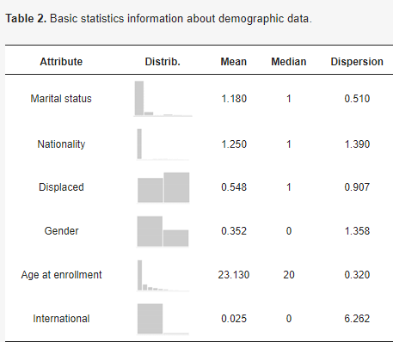
Basic Statistical Demographic Information

Slide 13
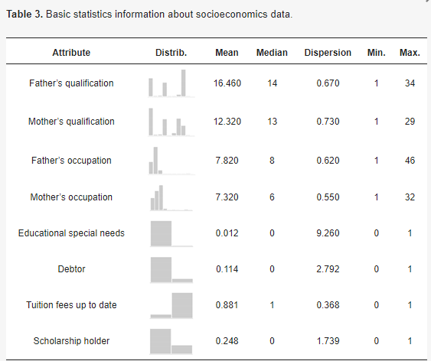
Basic Statistical Socioeconomic Information

Slide 14
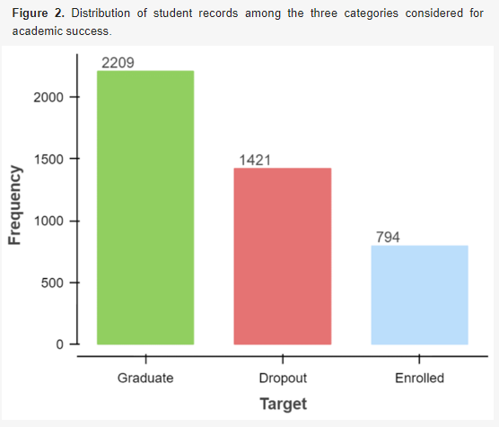
The data is divided into three target groups: Graduate, Dropout, and Enrolled Students.
The data is not evenly distributed among the three target groups. The graduate group has 1,415 more records than the enrolled group.

Slide 15
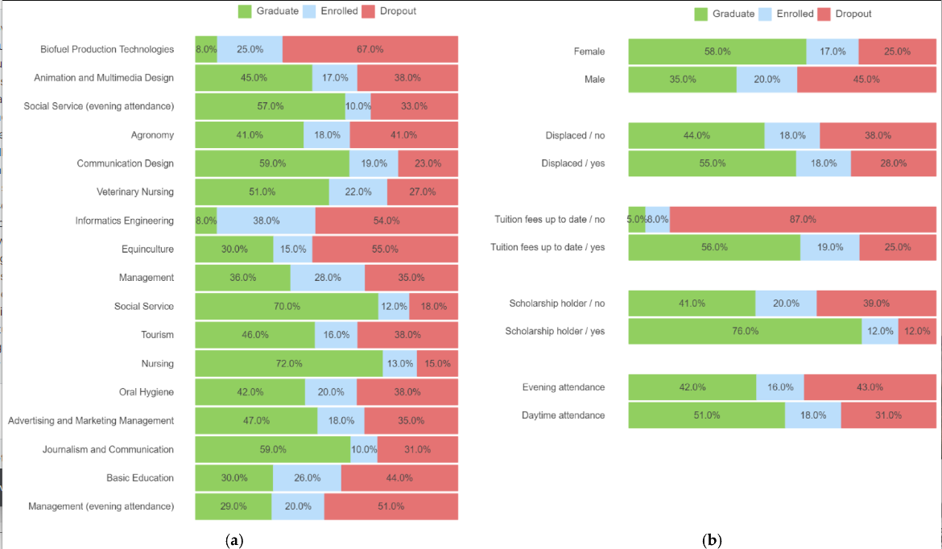
Student outcomes also show a very uneven distribution

Slide 16
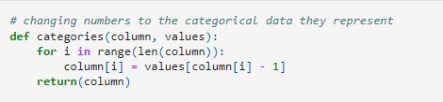
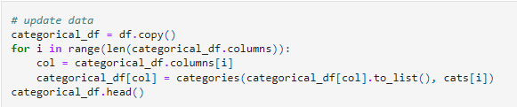
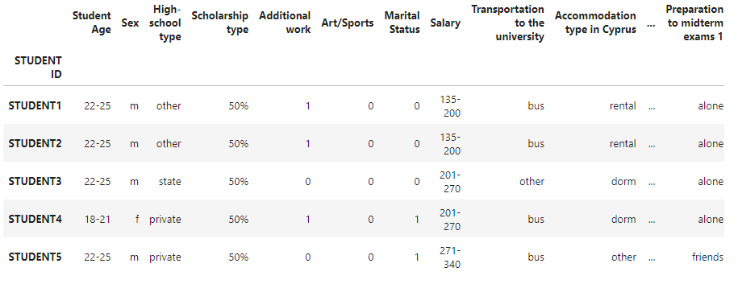
Data Crunching
The original dataset was all numerical including the headers. The data was changed to include named headings and defined variables to make the data easier to understand. The data was also split into sections to make it easier to work with.

Slide 17
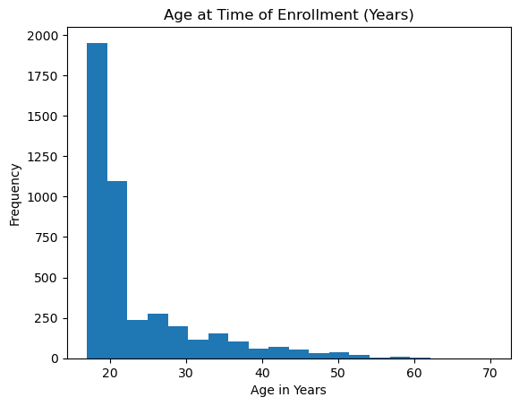
Most of the students were young adults
ax = df['Age at enrollment'].plot(kind='hist',
bins=20,
title='Age at Time of Enrollment (Years)')
ax.set_xlabel('Age in Years')

Slide 18
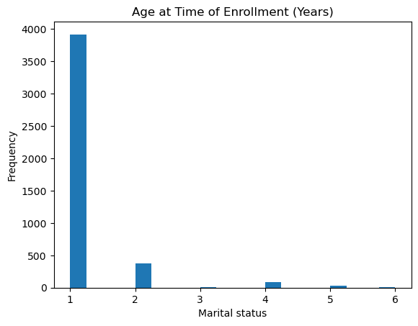
Most of the Students were Single
ax = df['Marital status'].plot(kind='hist',
bins=20,
title='Marital Status')
ax.set_xlabel('Marital status')

Slide 19
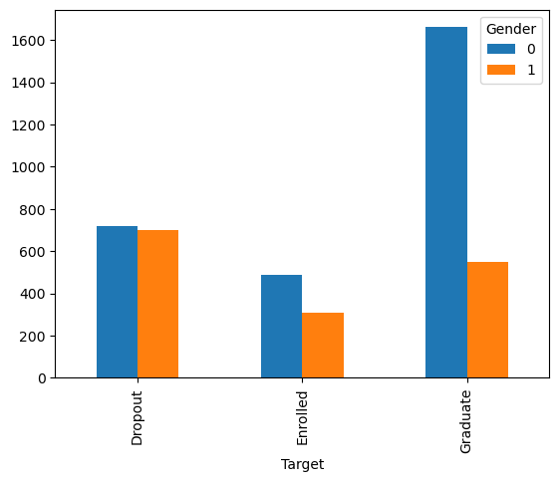
Gender and Enrollment
0 = female
1 = male
gender_column = "Gender"
df_subset.groupby(["Target", gender_column]).size().unstack(level=1).plot(kind='bar')

Slide 20

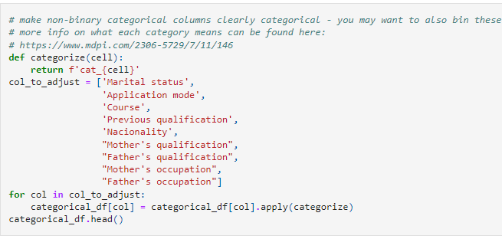
Project Steps – Supervised Machine Learning
1) Data was split by data type
2) Form non-binary categorical columns

